Slide 1
Kubernetes + Istio
Container Native Applicaiton, Kubernetes
Jupil Hwang
@jupil_hwang
Sales Consultant, Cloud Infrastructure
16 DEC, 2017

Slide 2
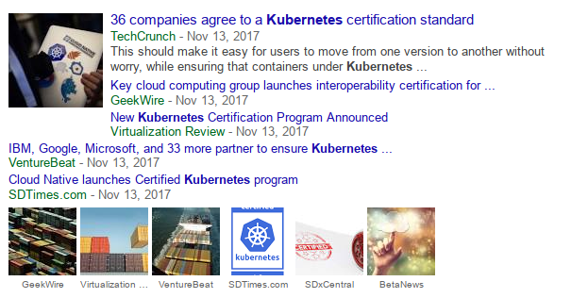
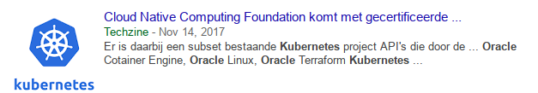
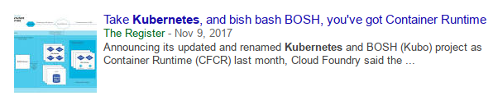
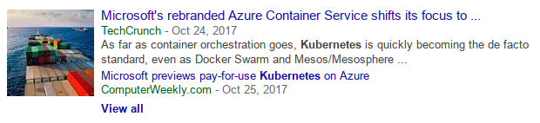
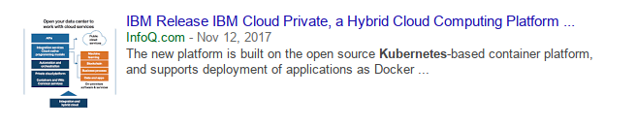
Kubernetes ?????

Slide 3

BEA Systems
Oracle Corp.
Middleware
Open Source, Cloud Native Application
DevRel
Linux, Open Source, Docker, Kubernetes
Blockchain, AI/ML
Lifelong learner
jupil.hwang@gmail.com

Slide 4
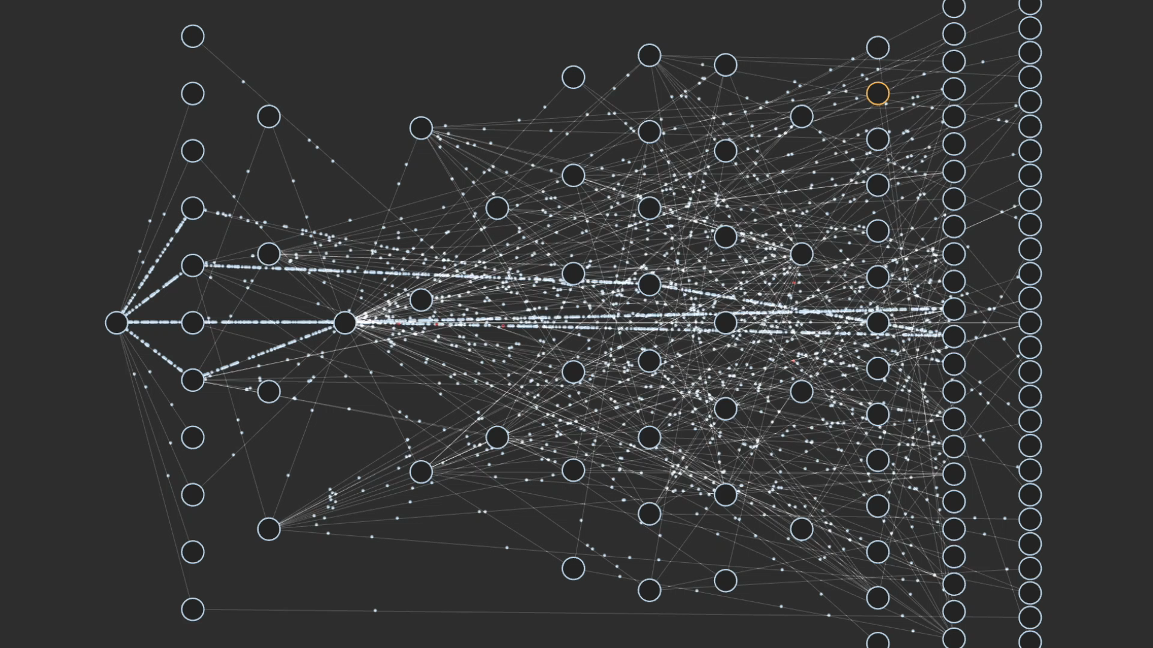
Edge
Middle Tier & Platform
Zuul (Proxy Svc)
EVCache
Load Balancer
API
(g/w)
Cassandra
Playback (Legacy Dev.)

Slide 5
Docker 란?
손쉽게 Container기술을 사용할 수 있도록 도와 주는 소프트웨어
2013년 3월 처음 소개됨
chroot(1979),BSD jail(2000),Solaris Zones(2004),LXC(2008)
"Modern App Platform" - Build, Ship, Run
중요기반기술
cgroups
namespaces (Process ID, Mount,UTS,User ID,IPC, Network etc..)
union-capable file system (OverlayFS, AuFS etc..)

Slide 6
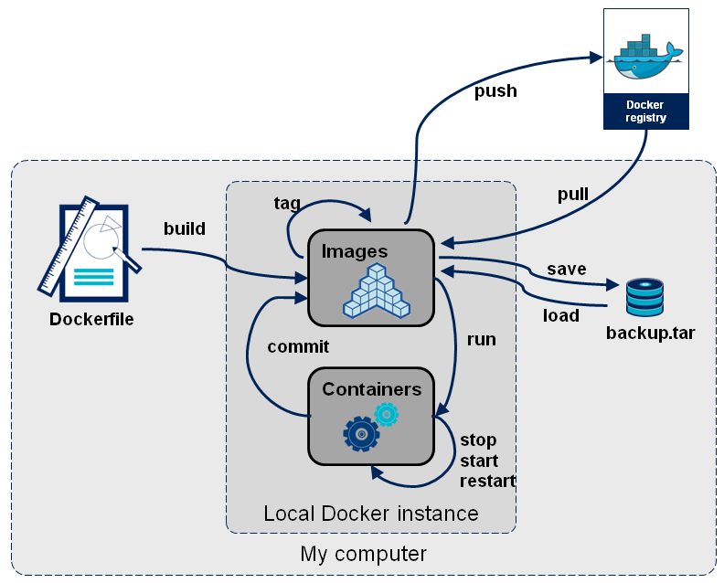
Docker Workflow !!
출처: https://dzone.com/articles/docker-crash-course

Slide 7
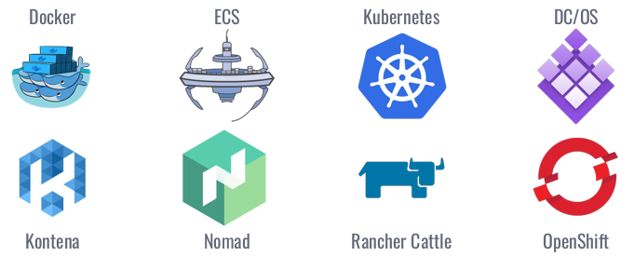
Container Orchestration
Developer
Core Concepts
Cluster
Single Container
Multi Container
Service Discovery & LB
Persistent Volumes
Local development
Ops
Multiple master
Scheduler
Rules and constraints
Monitoring
Rolling Update
Cloud/Commercial support

Slide 8
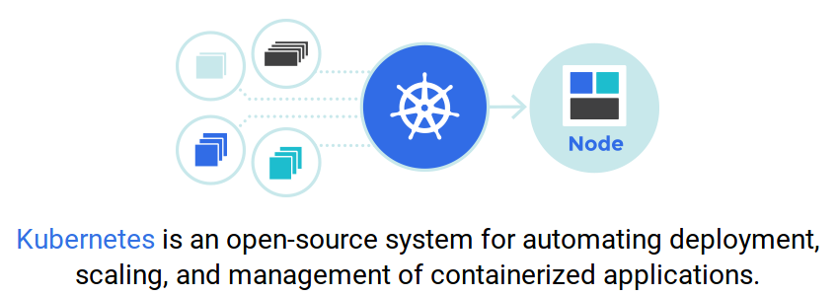
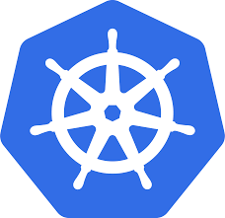
Kubernetes
컨테이너 오케스트레이션 툴
2014년7월 Google에서 Borg & Omega 프로젝트를 발전하여 소개
2015년 7월 v1 발표 - Cloud Native Computing Foundation (CNCF) 기부, 2017년 현재 v1.8.1 Stable

Slide 9
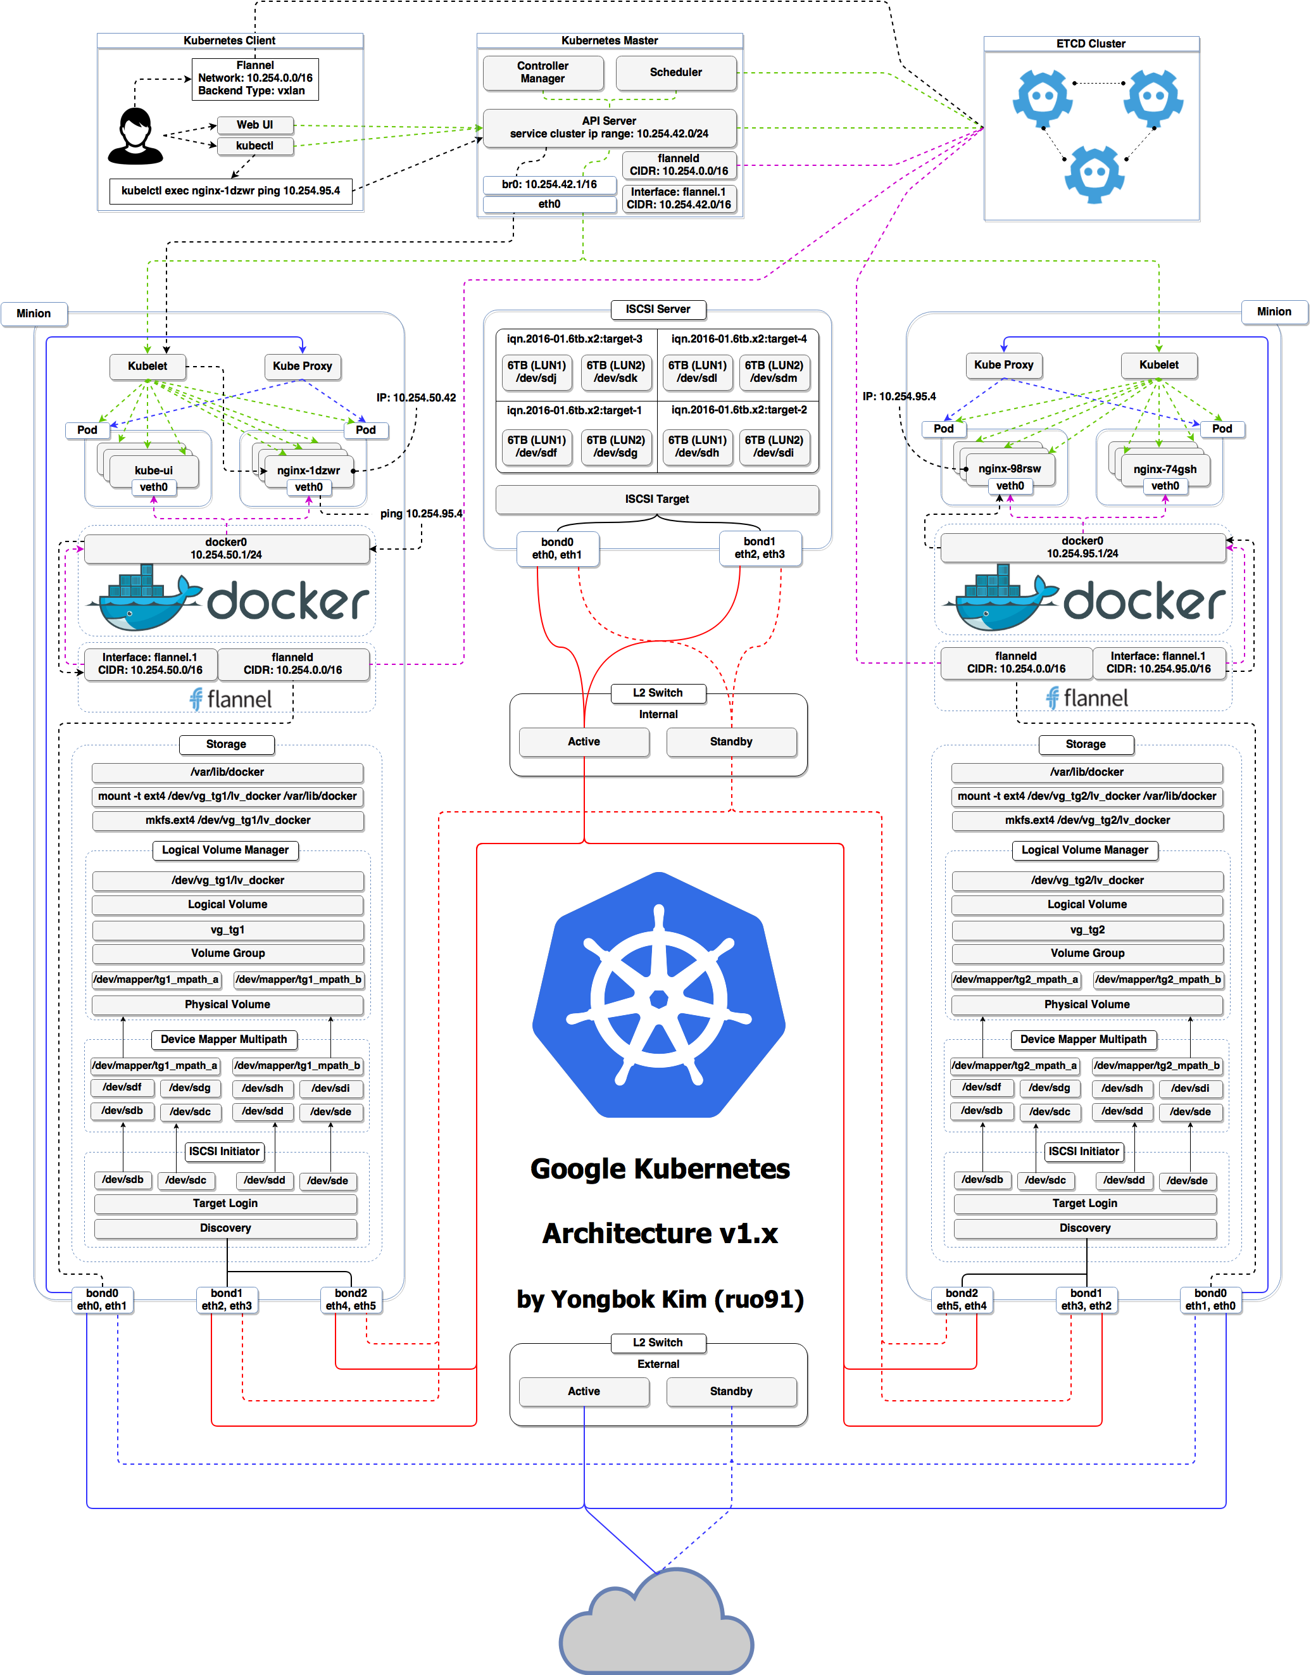

Kubernetes Architecture
출처: https://cdn.yongbok.net/ruo91/architecture/k8s/v1.1/kubernetes_architecture.png

Slide 10
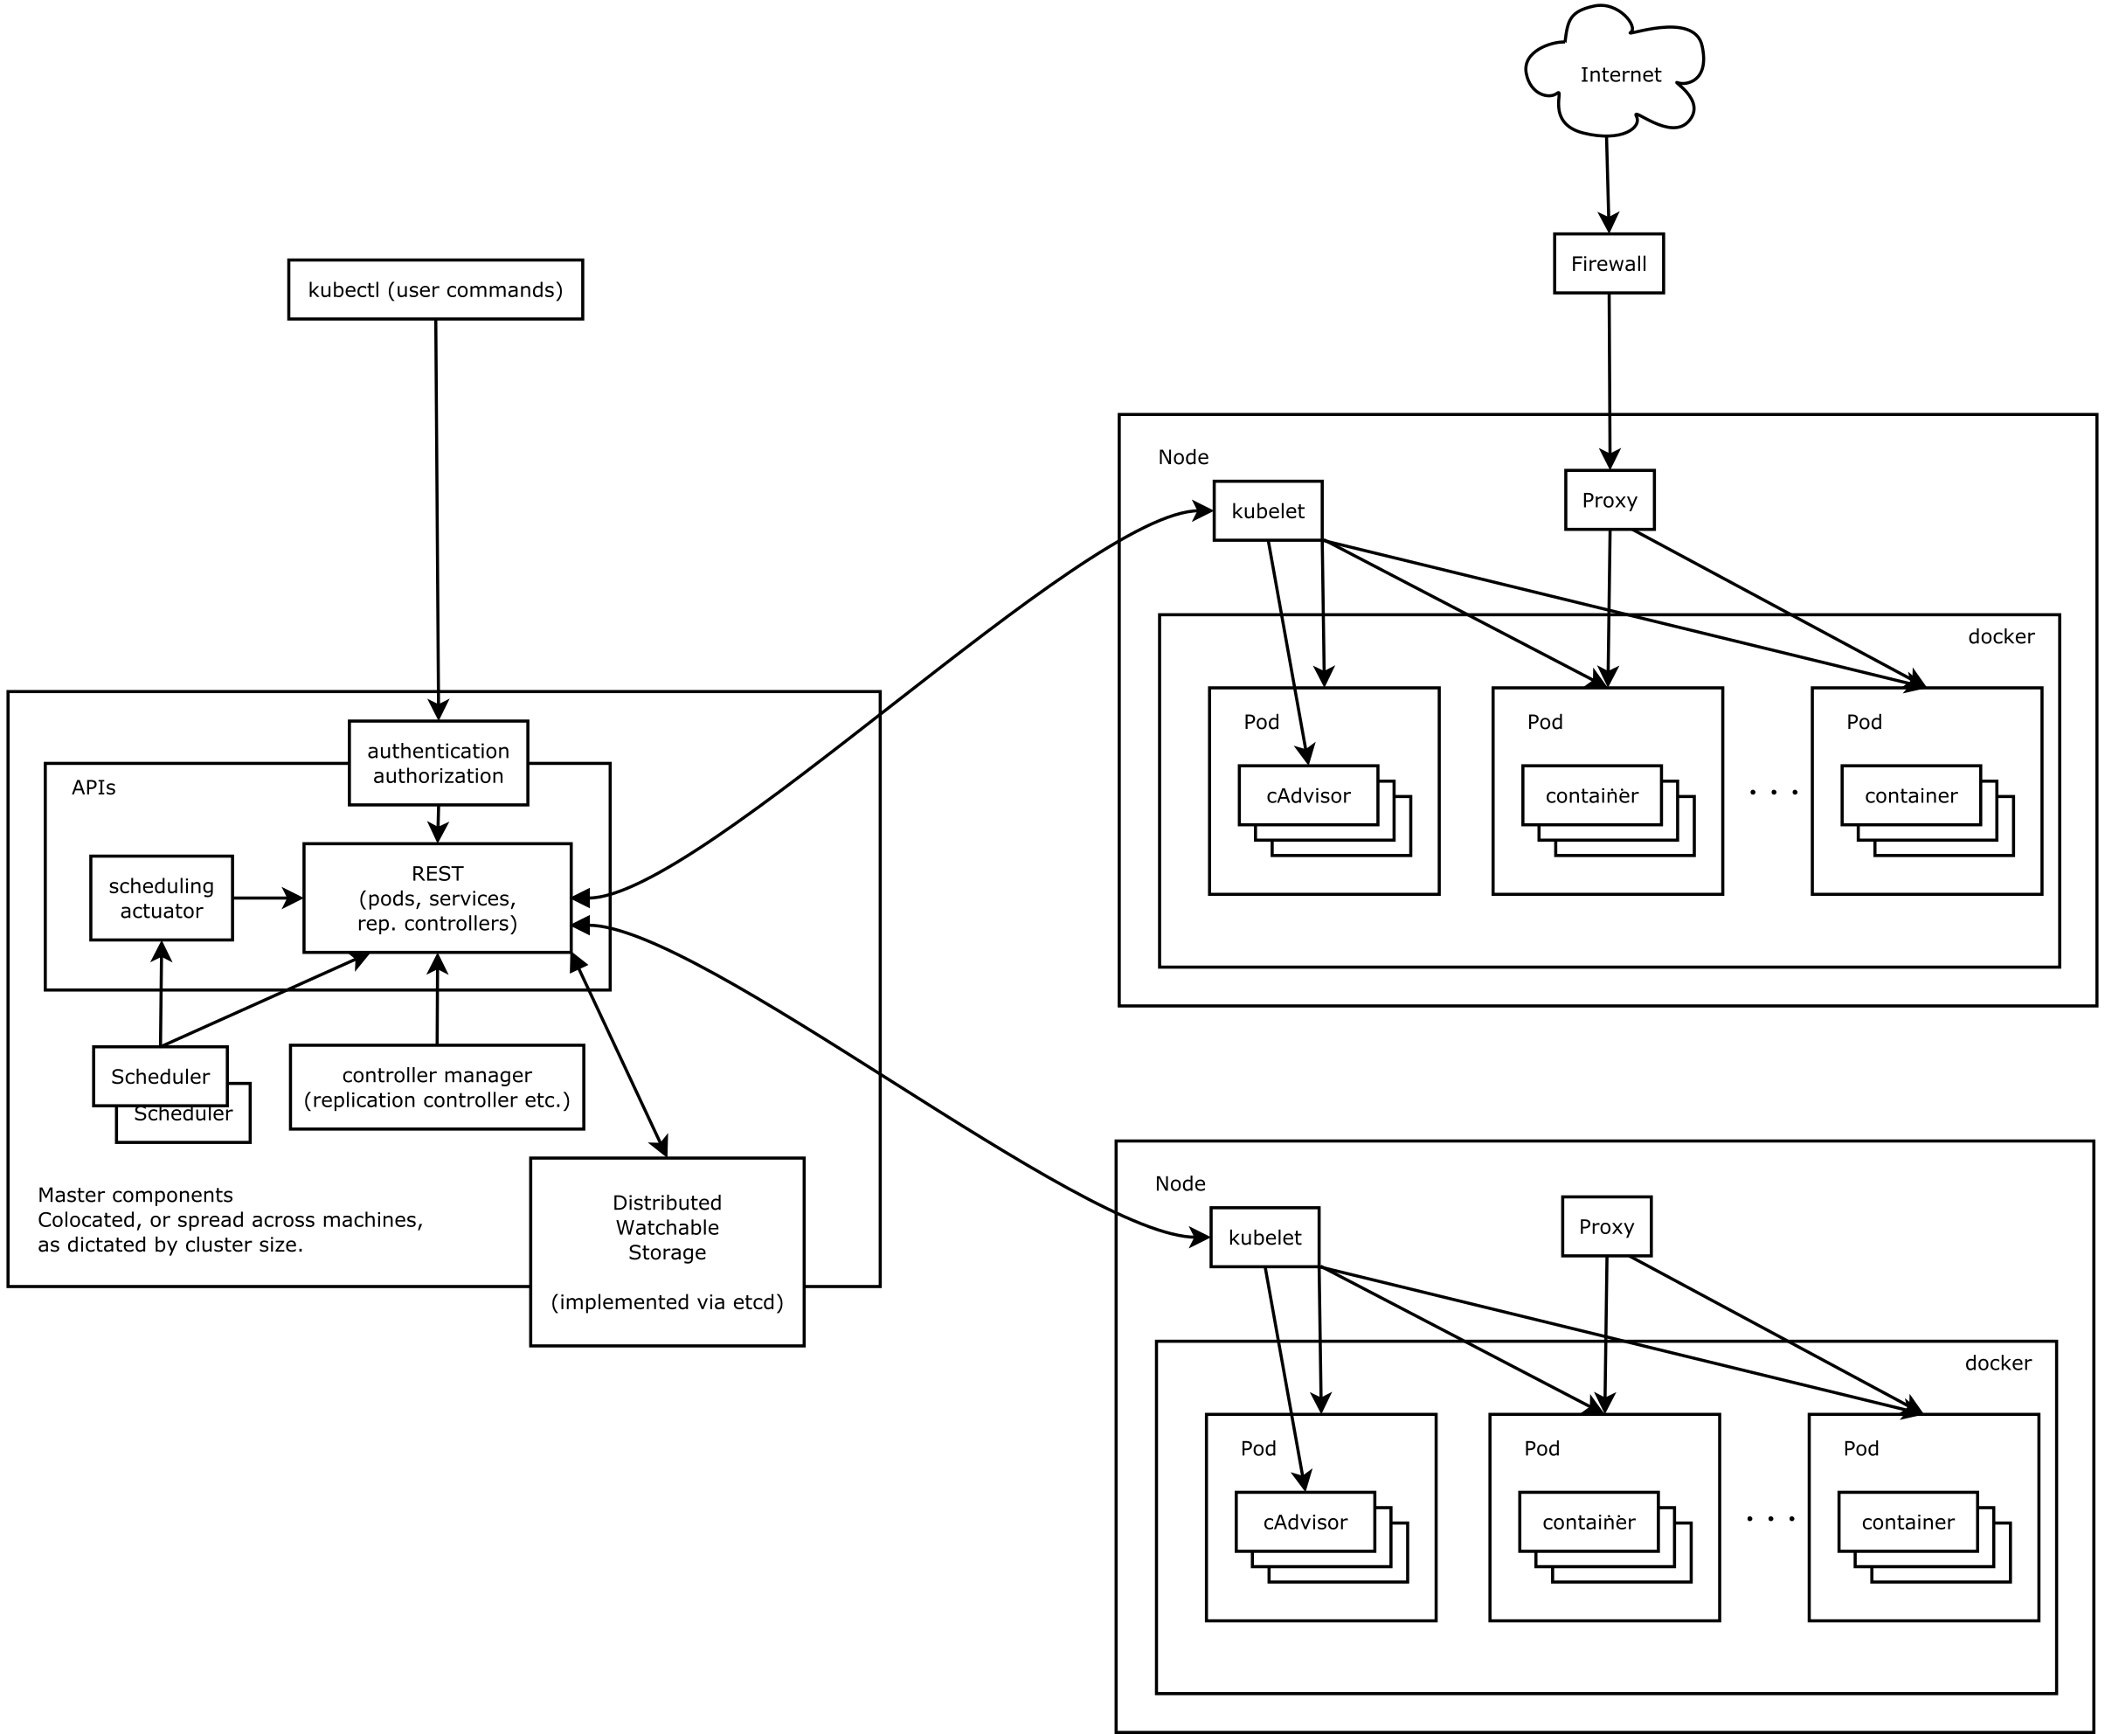
Kubernetes Architecture
Load Balancer
cAdvisor/Heapster
cAdvisor/Heapster

Slide 12
sidecar 패턴???

Slide 13
Istio

Slide 14
Istio vs Kube-proxy

Slide 15
Istio Architecture

Slide 16
Istio
Envoy??
Ingress ??

Slide 17
Kubernetes - 노드
Master 노드 --> Cluster control plane
클러스터에 대한 관리 역할
API Server : RESTFul API를 이용해서 Client, Woker 노드와 통신
Scheduler 및 Replication Controller
Worker 노드
실제 Container가 실행되어 사용자가 사용할 수 있도록 서비스를 제공
etcd 노드
분산 KVS
K8s 클러스터의 모든 상태를 저장
K8s API Object 저장

Slide 18
Kubernetes - 등등
Kubelet
각 노드에서 동작하는 Agent로, Container Runtime(docker, rkt..)로 연동
노드의 health check도 담당
kube-Proxy
외부의 사용자 요청을 처리, 서비스들의 Load-Balancer
iptables사용
cAdvisor / Heapster
각 노드의 리소스 모니터링
Ingress Controller
L7 기반의 Load-Balancing 지원 (예, /foo vs /bar)

Slide 19
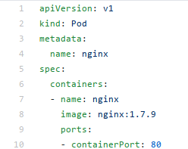
Kubernetes - Pod
Dynamic IP
172.17.1.100
동일한 Lifecycle을 가지는 하나 또는 여러개의 컨테이너들을 가짐
Pod당 하나의 IP
Block Storage, Secret, Config 을 공유, container끼리는 localhost로 통신가능
Ephemeral
Container가 재시작하더라도 Pod이 살아있는한 Shared volume은 유지
Pod
Container
예) Nginx
Container
예) Web Files
Block
Secret
config

Slide 20
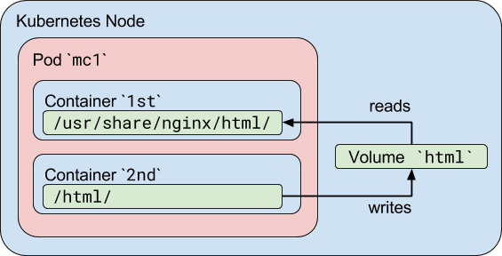
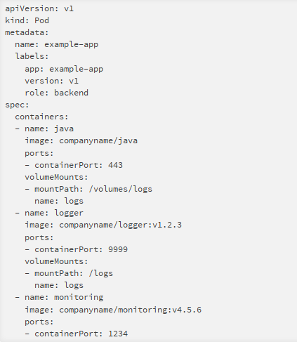
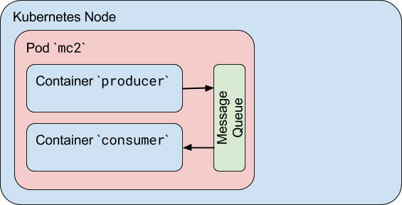
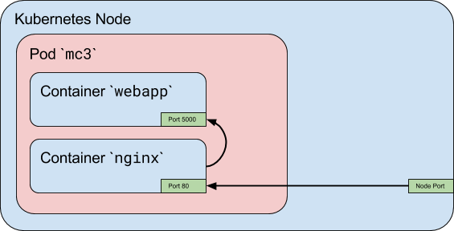
Kubernetes - Pod

Slide 21
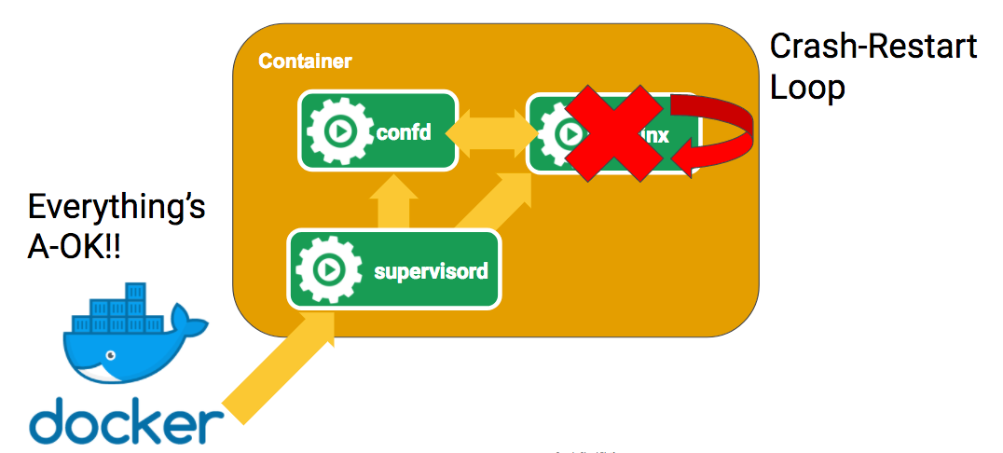
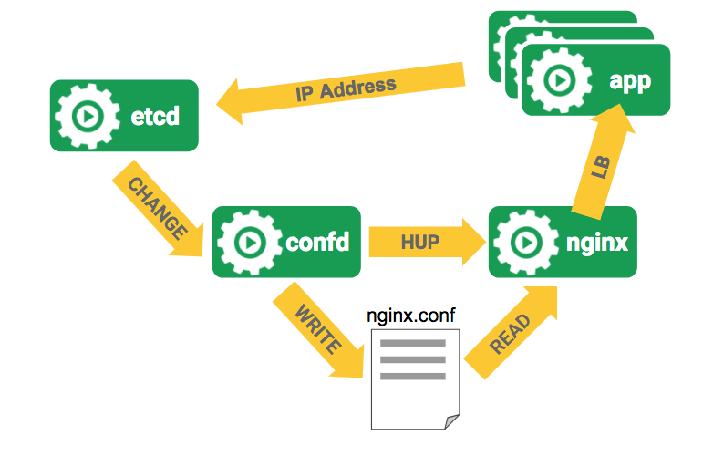
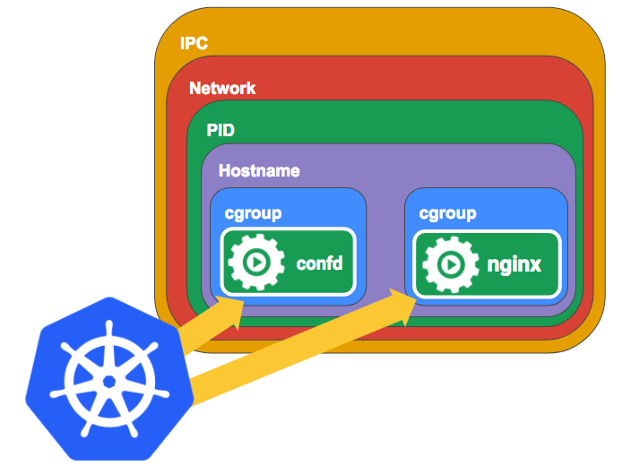
Kubernetes - Pod

Slide 22
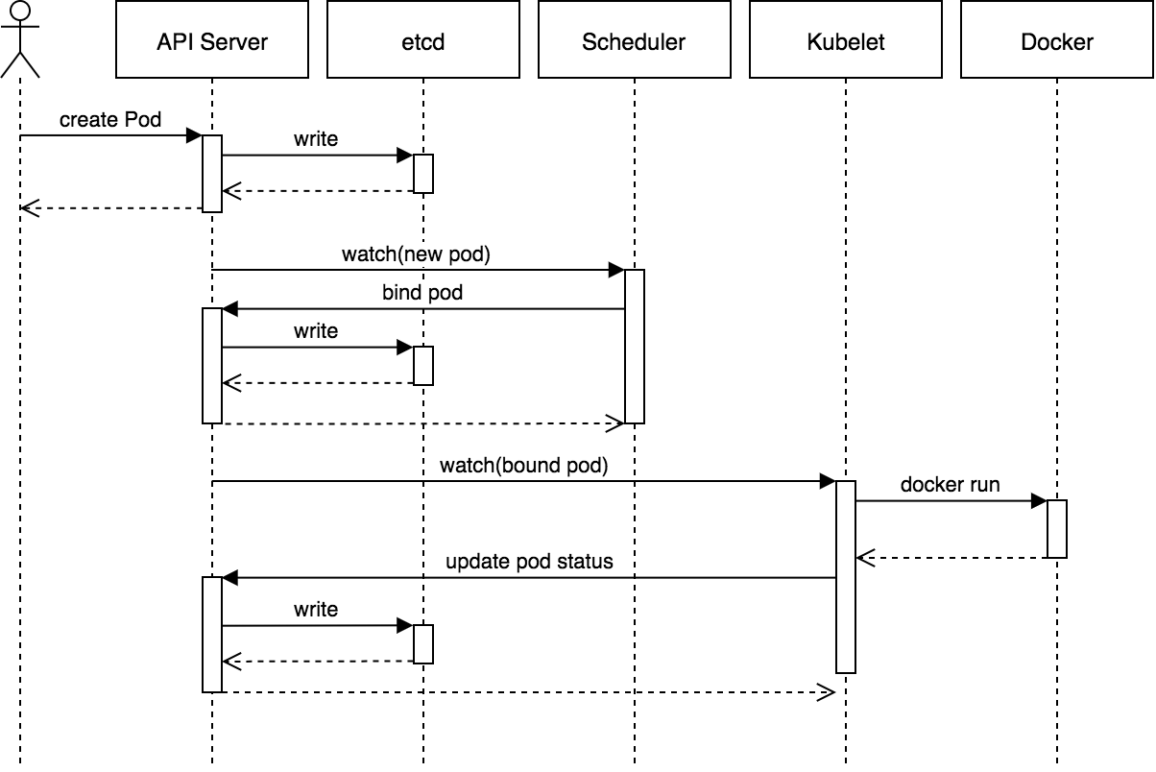
Kubernetes - Replication Controller & Scheduler
출처: https://www.cncf.io/blog/2017/11/07/joe-beda-explains-inner-workings-kubernetes/

Slide 23
Kubernetes - Replication Controller & Scheduler
Node
Pods
Containers
master
Schedule
Replication
Controller
......
Node
Schedule
Pods
Containers

Slide 24
Kubernetes - Replication Controller & Scheduler
비슷한것으로는 ....

Slide 25
Kubernetes - Services
FrontEnd
Pod
K8s의 모든 component는 Pod으로 등록이 되며, 여러개의 Pods를 하나의 서비스로 관리
component communication에 service를 사용
Service
Backend Service 1
Pod
Pod
Dynamic IP address
Service
Pod
Service
Service
Redis
Fixed, Virtual IP Address
DNS Integration
Update when Backends change
Backend Service 2
Dynamic IP address
Pod
Pod

Slide 26
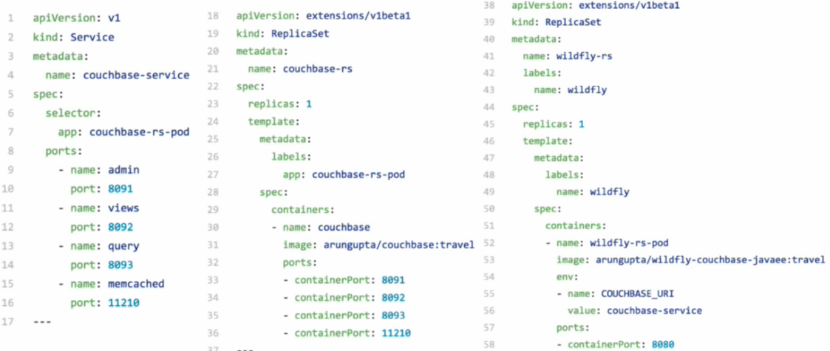
Kubernetes - Service Discovery (예)

Slide 27
Kubernetes - Service Discovery (예)
Node
Wildfly
Couchbase Service
Couchbase

Slide 28
Kubernetes - Service Discovery (예)
Node
Wildfly
ReplicaSet
Wildfly
Wildfly
Couchbase Service
Couchbase
ReplicaSet
Couchbase

Slide 29
Kubernetes - 기타
Secret & ConfigMap
Pet Set : stateful applications (예.클러스터링) 지원
Labels : pod, service 등을 동일한 label로 관리 가능
Deployments
rolling update, rollback 등을 지원하는 pod, replica set
Namespace
Volume : emptyDir, NFS, iSCSI, GFS, CephFS etc....
Persistent Volume : networked storage개념

Slide 30
Kubernetes - Volume
PersistentVolumeClaim
PersistentVolume
Request Storage
PersistentVolumeClaim
Use Claim
claims are mounted as volumes
Provision Network Storage
PersistentVolume
1
2
3

Slide 31
Kubernetes Tools
kubectl
Kubernetes API의 CLI
kubeconfig 파일에 정의된 정보를 사용 (cluster, context, security etc..)
kubectl create -f my-rc.yml
kubectl create -f my-pod.yml -f my-service.yml
kubectl create -f http://github.com/namoo4u/k8s/nginx.yml
kubectl get pods
kubectl get component -o wide
kubectl get svc

Slide 32
Kubernetes Tools
kubeadm
helm
Kube charts : curated applications
minikube
virtualbox 기반의 single node cluster 제공
가장 간편하게 kubernetes환경에서 개발/테스트를 할 수 있음.
CoreOS-Kubernetes-Vagrant 환경
https://github.com/coreos/coreos-kubernetes

Slide 33
Oracle Linux Container Service
kubeadm-setup.sh 제공
/bin/kubeadm-setup.sh up
/bin/kubeadm-setup.sh up --pod-network-cidr ip/netmask
/bin/kubeadm-setup.sh down
/bin/kubeadm-setup.sh join --token token master_ip:port
/bin/kubeadm-setup.sh restart
/bin/kubeadm-setup.sh stop
/bin/kubeadm-setup.sh backup directory
/bin/kubeadm-setup.sh restore backup-file.tar

Slide 34
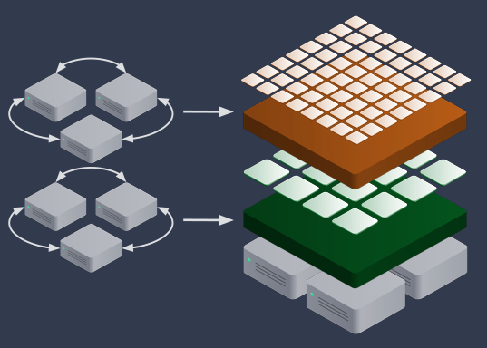
Kubernetes on Baremetal
Actions
on
Fuction Platform (FaaS)
on
Container Platform (CaaS)
on
Baremetal
출처: https://www.slideshare.net/KarlIsenberg/container-orchestration-wars-2017-edition

Slide 35
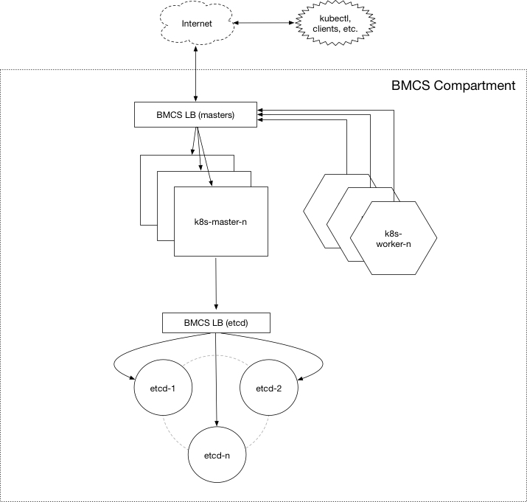
Kubernetes Installer (OCI환경, Terraform)
오라클에서 OCI환경에서 Kubernetes를 쉽게 구성하기 위해서 개발
오픈소스
Github : https:/github.com/oracle/terraform-kubernetes-installer
주요기능
OCI tenancy 와 compartment에 Kubernetes 클러스터를 바로 구성
VCN, subnets, 로드밸런서 그리고 인스턴스 생성
클러스터를 위한 노드의 종류나 수 지정 가능
필요시 클러스터 크기/수 조정 가능

Slide 36
Container Pipeline, Container Engine
잠시만 보고 가시죠

Slide 37






Oracle Cloud Platform - 50s+
BACK-END SERVICES
EE
F(x)
FRONT-END TOOLING
Application Container
Java
Functions
Mobile
SDKs (3rd Party, JET)
Mobile Accelerator
Application Express
App Builder
COMMON SERVICES
Continuous Delivery
(Developer/Container Pipelines)
Container Cloud (Docker, Orchestration)
APM/Log Analytics
Event Hub (Kafka) Cloud
Messaging Cloud
API Catalog/ Management
Identity
DATA SERVICES
INTEGRATION SERVICES
MySQL
Data Hub
B
Database
Big Data
Integration
SOA
Internet of Things
Compute (OCI, VM, Containers)
Network (VCN, LB, CDN, DNS, FC)
Storage (Local, Block, Object)
Infrastructure as a Service
Global Infrastructure (29 Regions WW)

Slide 38







Container Native Application Development Platform
Foo1
Foo2
API Registry
Event Management
Open Service Broker
ISTIO
Diagnostics/Monitoring
Prometheus
Developer Cloud
ISTIO
Managed Kubernetes

Slide 39
Service Mesh : istio
클러스터내의 Container들 네트워크는 monitored, managed,controlled 되어야 함
Side Car 패턴을 통해서 Application code 의 변경없이도 Microservice Architecture 의 다양한 필수 기능(Service discovery, Load balancing, Circuit Breaker, Monitoring, Service-to-service authentication 등)을 제공
---> Traffic Management
kubectl apply -f <(istioctl kube-inject -f samples/sleep/sleep.yaml)

Slide 40
Service Mesh : istio
자세한 것은 다음달에..

Slide 41
Oracle Cloud Native Application Development Platform Integrated Suite of Container Native Capabilities
fn
Container Pipelines
Container Engine
Container
Microservices
Container Functions
Container Diagnostics
A market leading solution for application lifecycle management with a Docker centric product view
Fully managed container service based on Kubernetes running on Oracle Cloud Infrastructure Bare Metal
A collection of services, frameworks and libraries for the modern cloud developer; based on Cloud Native Compute Foundation – Istio/Envoy
Open source, cloud neutral, community driven functions as a Service for any language, best of class for Java
Unparalleled real-time observability and diagnostics for large scale distributed Java systems
Build --- Deploy --- Operate

Slide 42
Q&A

Slide 43
See you Again !!!

